Slide 1
ROAD CONDITION MONITORING SYSTEM BASED ON NORDIC THINGY:52

Slide 2
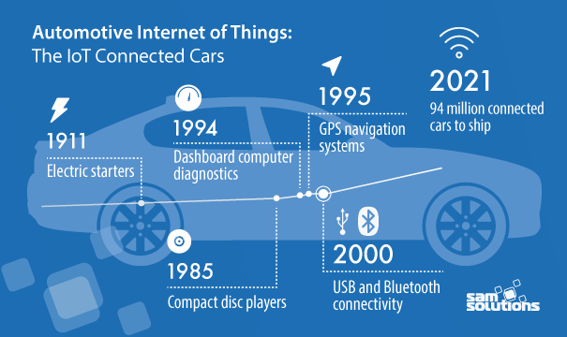
INTRODUCTION
The majority of accidents on the road are due to human error, and these could be reduced through IoT technology.
The applications of IoT in the automotive industry are countless and could help bring down the number of accidents not only by monitoring the driver’s condition but also the state of infrastructures.

Slide 3
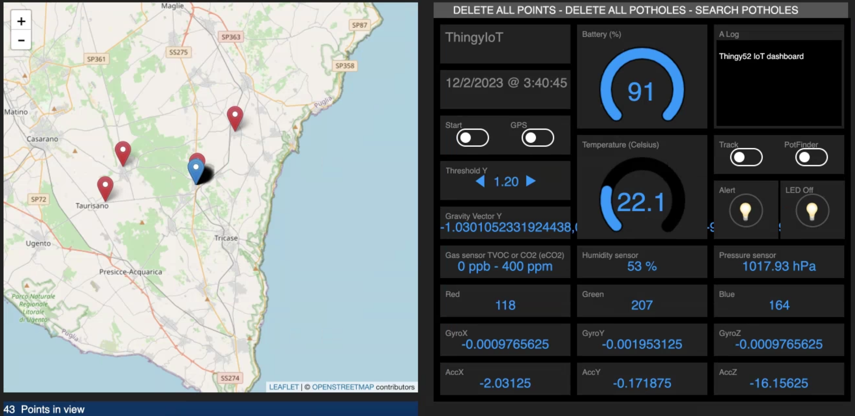
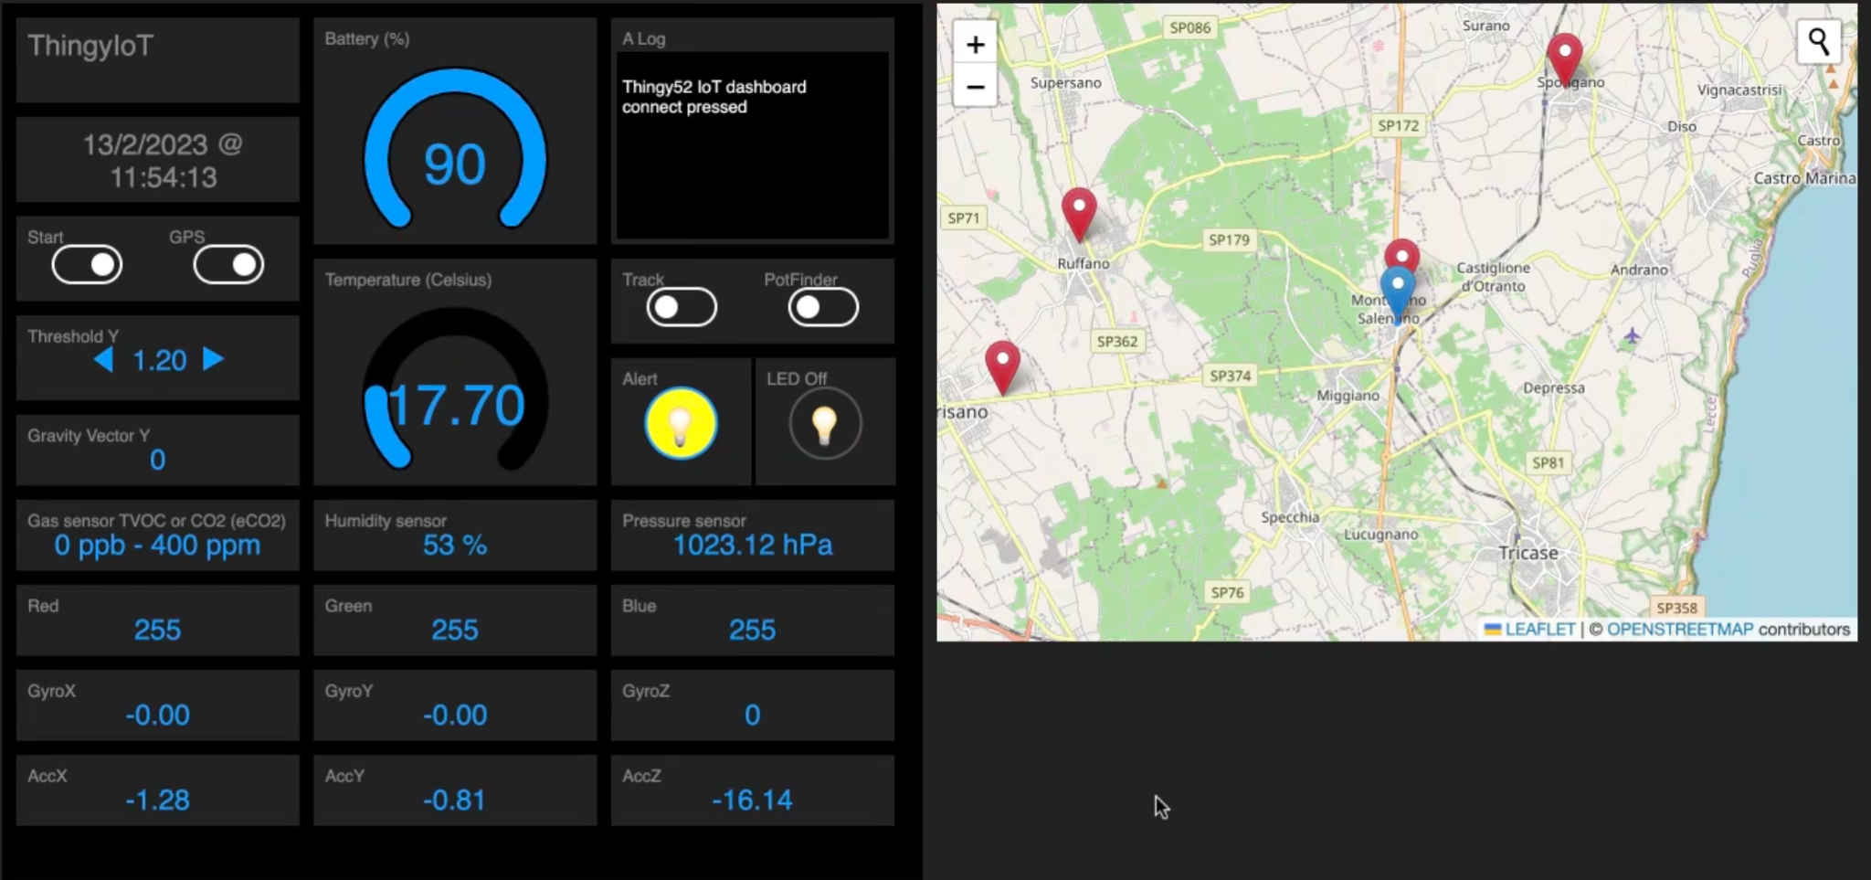
OBJECTIVES
This project aims to offer an aid to road condition monitoring and maintenance.
This can be realized by:
Reporting on a map the points with poor road conditions.
Alerting the driver when they are near to anomalies so they can pay more attention.
Contributing to road maintenance by gathering environmental data and road parameters.

Slide 4


RELATED WORKS
Features | IoT Based Pothole And Notification System | DeepBus | Road condition detection device (RCDD) | Intelligent Pothole detection | This Project
Accelerometer and gyroscope data
Machine learning model for detection
Detection relies on threshold
Manual pothole flagging
Alert system for the driver

Slide 5
REQUIREMENTS ANALYSIS
2.1 Functional Requirements:
End nodes with sensors (Nordic Thingy:52) acquire data from the environment (temperature, humidity).
End nodes with sensors acquire motion data (Nordic Thingy:52).
The device acquires positioning data for geolocation and time information (Smartphone: GPS location and timestamp).
A gateway aggregates the data and sends the data via REST (REpresentational State Transfer) API (Application Programming Interface) to the cloud server.
On a cloud server, a JSON (JavaScript Object Notation) database stores the captured data.
A dashboard for viewing the data from the operating devices showing the location of the current user alongside other information about the road.
A dashboard for viewing and querying all the historical data of all operating devices reported (from the database).
A dashboard for viewing the real-time captured data from the devices involved (via websocket).
A trained model elaborates captured data to flag the presence of potholes on the map.
An algorithm calculates the distance between the driver and the potholes.
The dashboard (in point f or h) includes retroactive feedback with an alert for the closest roads with poor conditions (i.e., < 500 meters).
The driver (LED on Thingy:52) gets a visual alert about poor road conditions.
The driver (alert sound on Thingy:52) gets an acoustic alert about poor road conditions.

Slide 6
REQUIREMENTS ANALYSIS
2.2 Non-Functional Requirements:
The system gets tested on good road conditions.
The system gets tested on poor road conditions.
The system could work without internet connection.

Slide 7
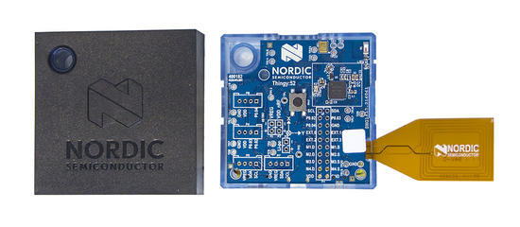

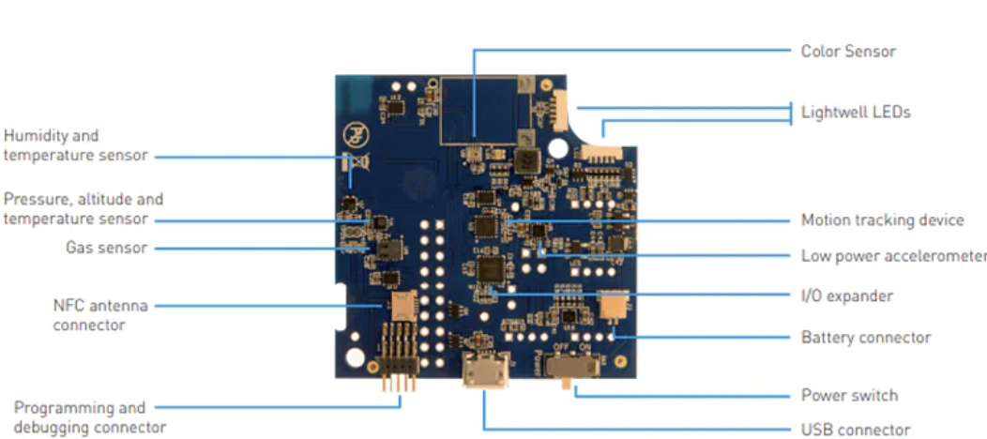
HARDWARE TECHNOLOGIES
Nordic Thingy:52
MPU-9250
Smartphone

Slide 8


SOFTWARE TECHNOLOGIES
JavaScript
JSON
HTML
HTTP
Python
NodeJS
Pandas library
Leaflet library
git
DuckDNS
Kaggle
Let’s Encrypt
Bluetooth 5.0
GPS

Slide 9
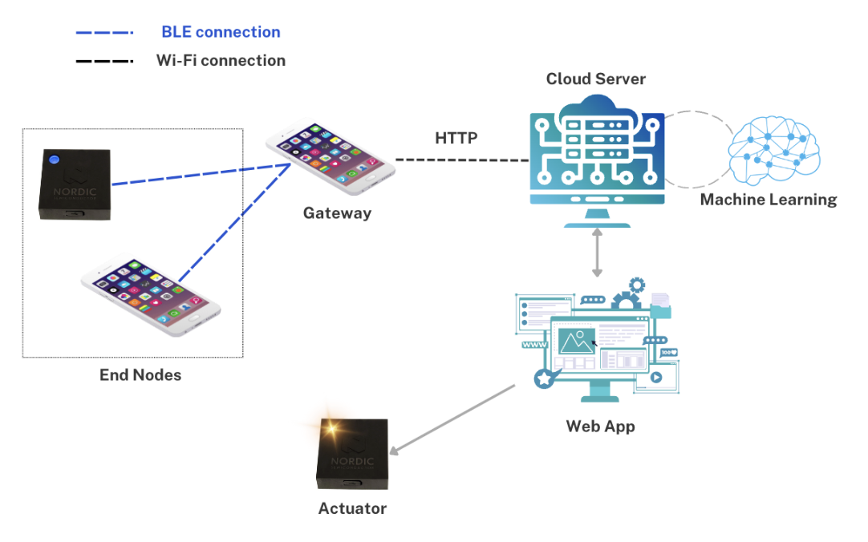
SYSTEM ARCHITECTURE

Slide 10
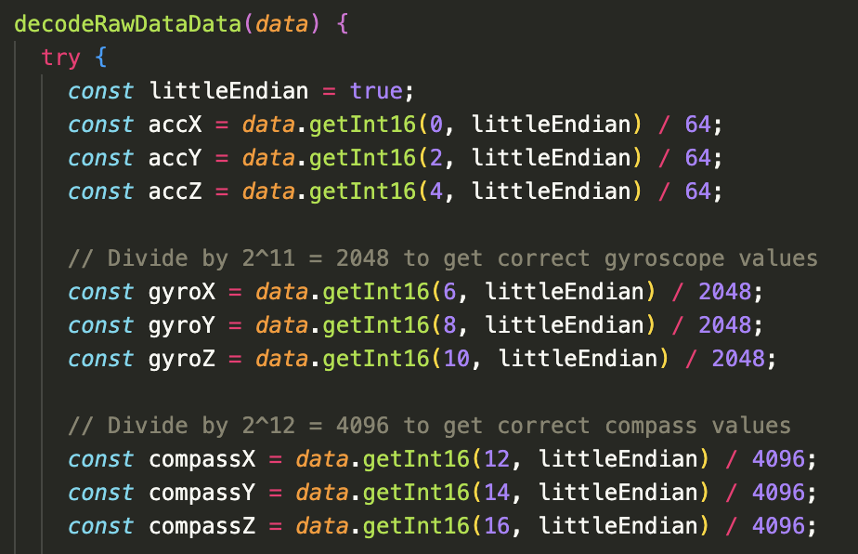
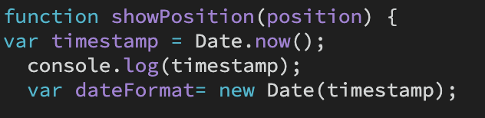
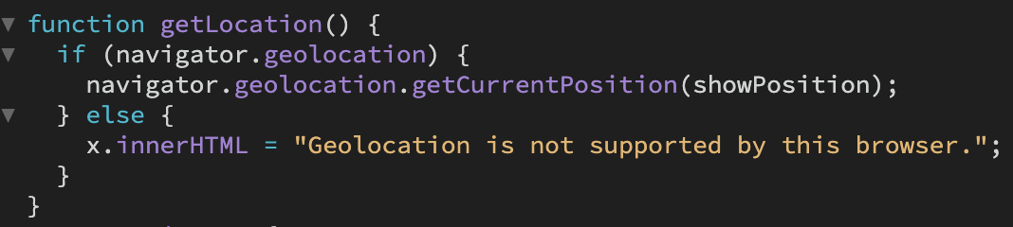
SYSTEM DETAILS - END NODES
Motion sensor data and geolocation

Slide 11
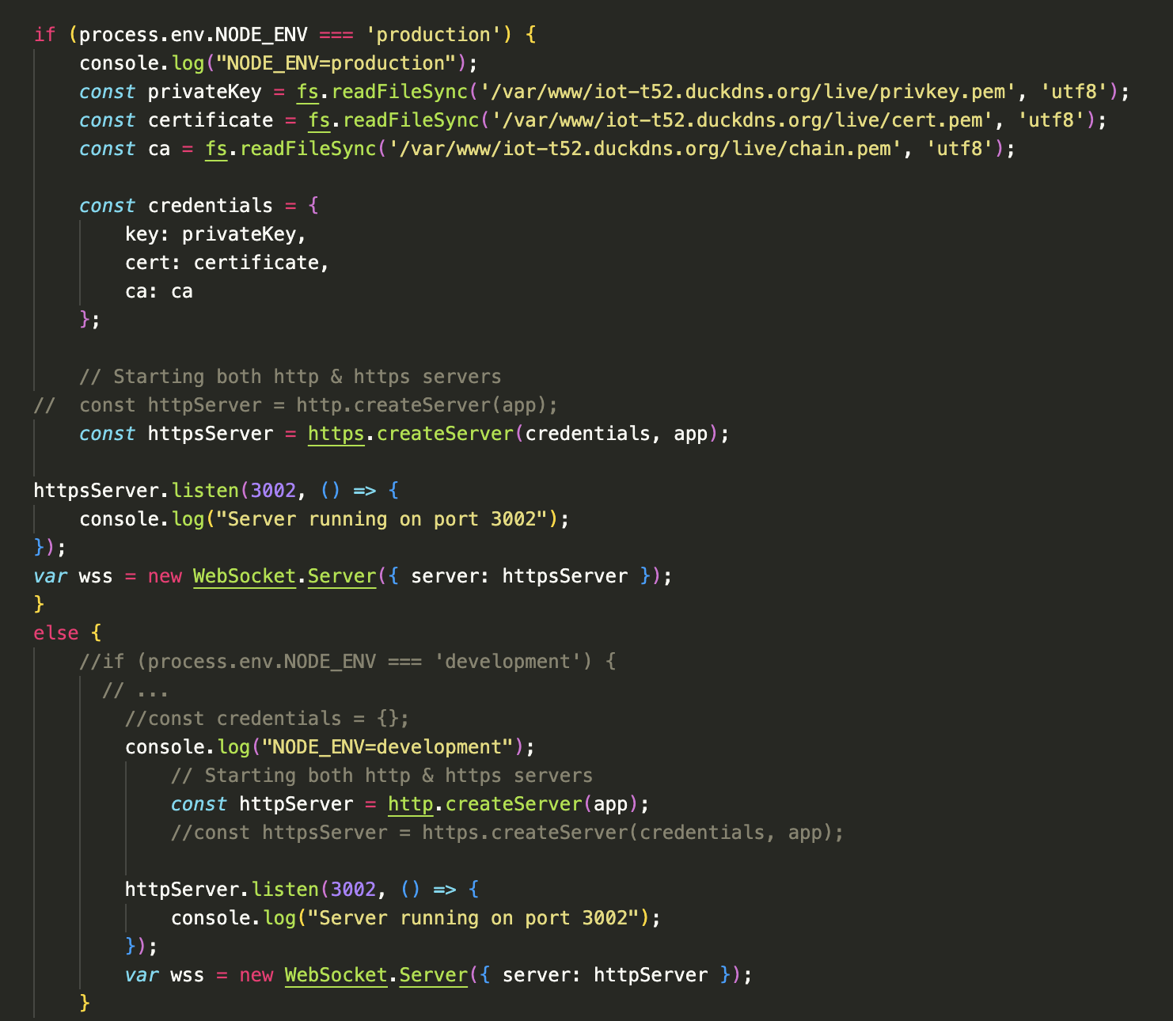
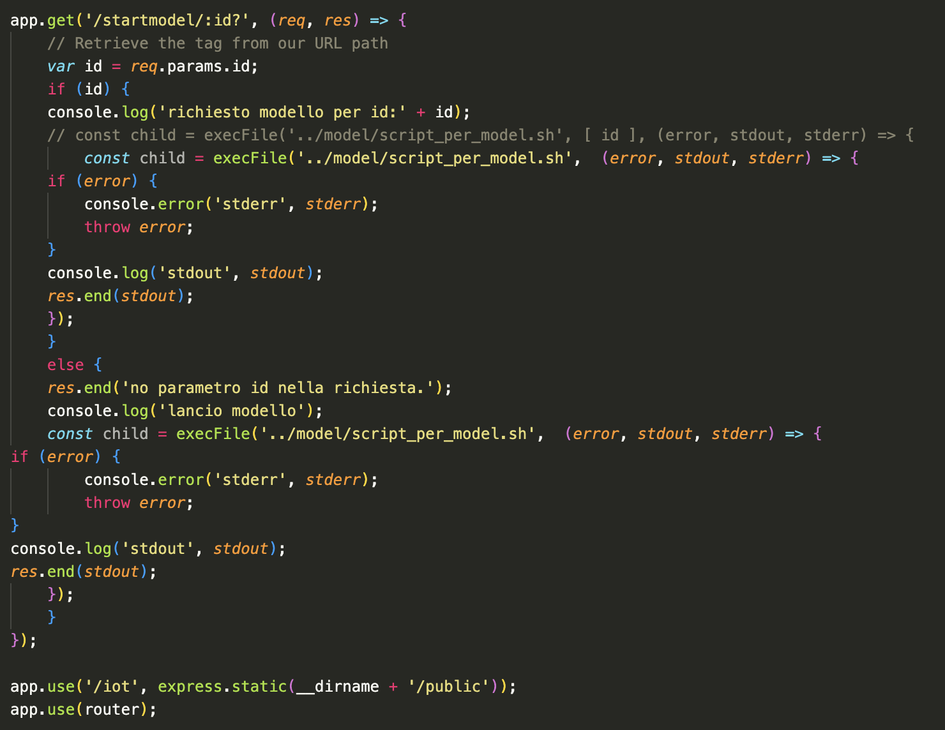
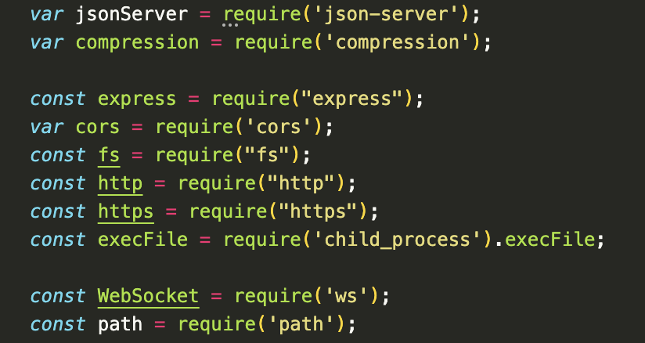
SYSTEM DETAILS - SERVER
Serverapp.js details

Slide 12
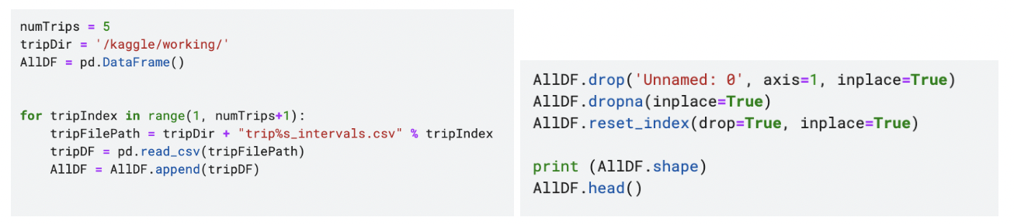
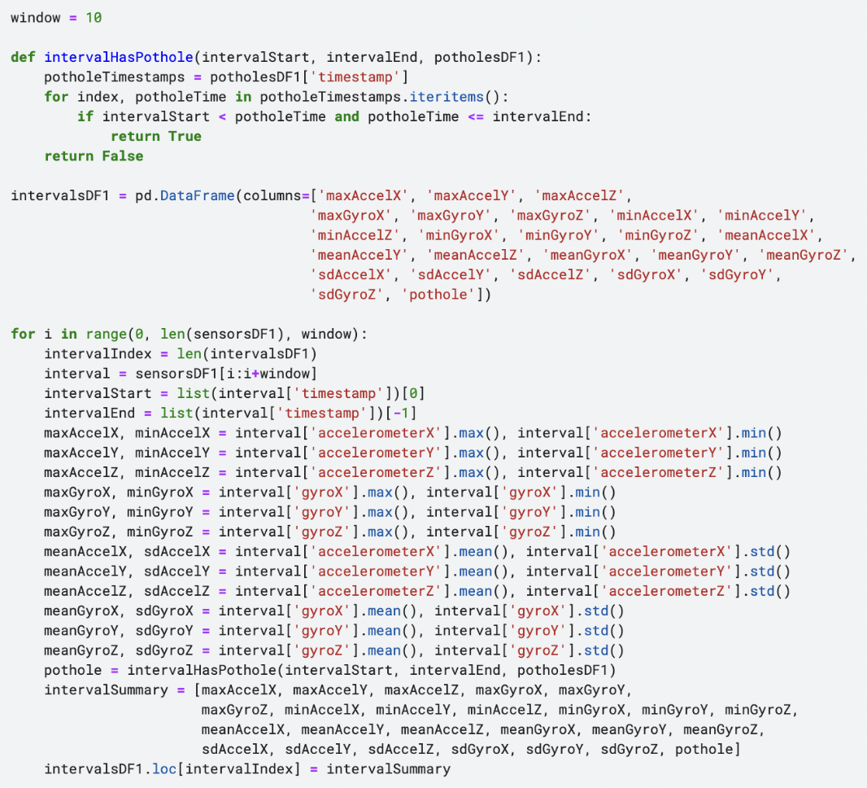
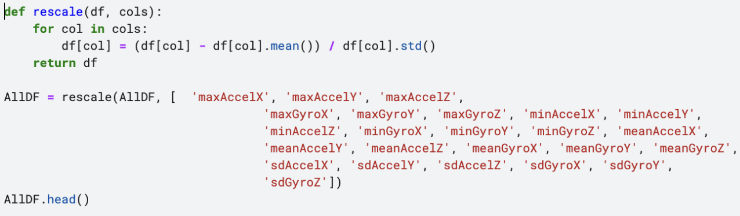
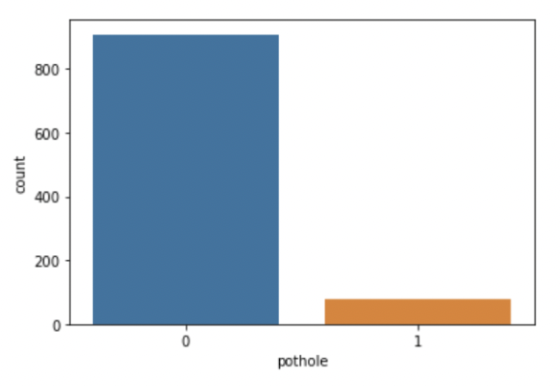
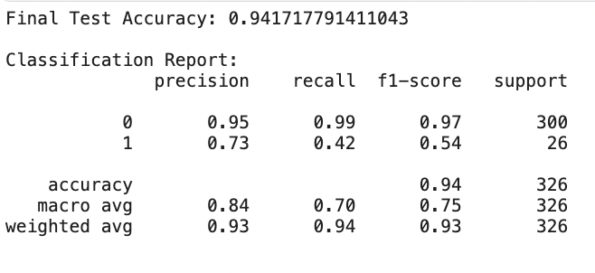
SYSTEM DETAILS - MACHINE LEARNING MODEL
Model training

Slide 13
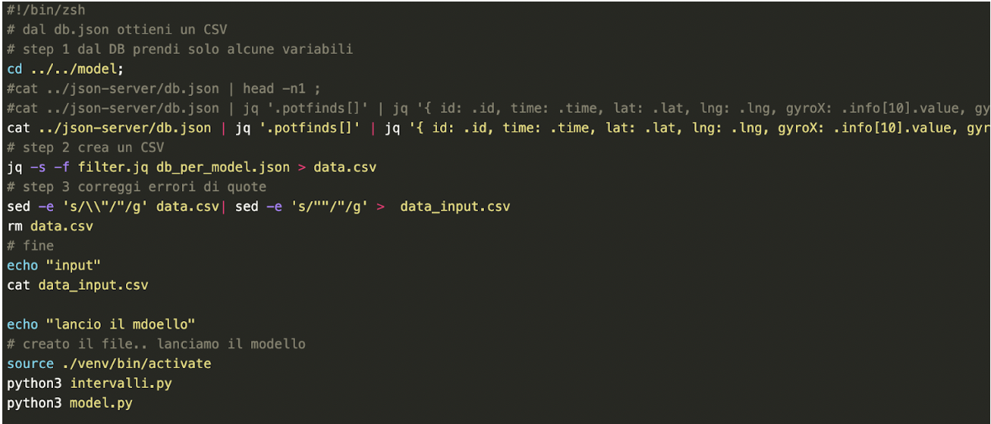
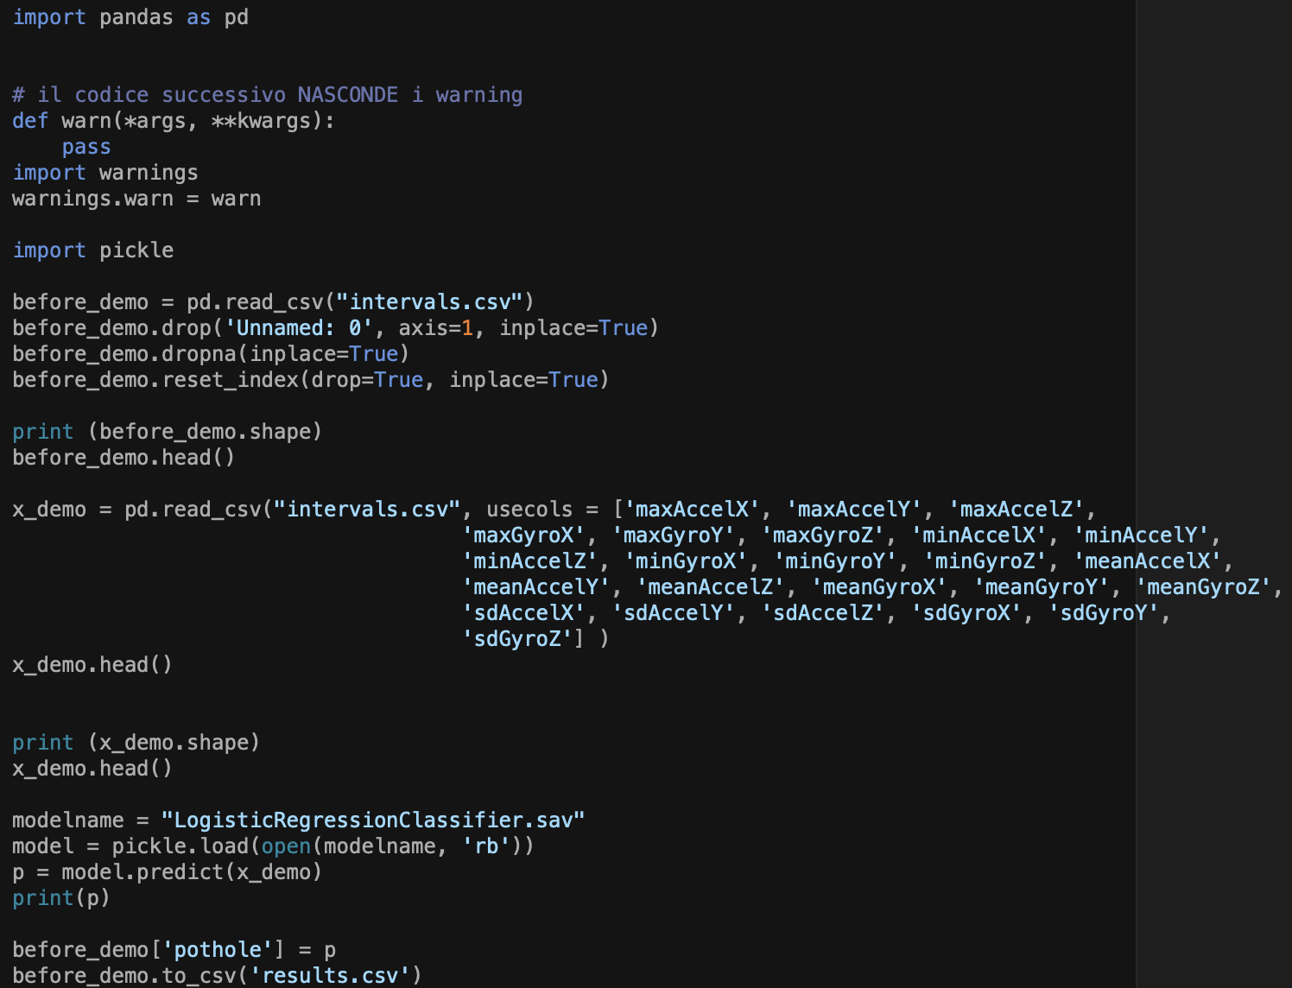
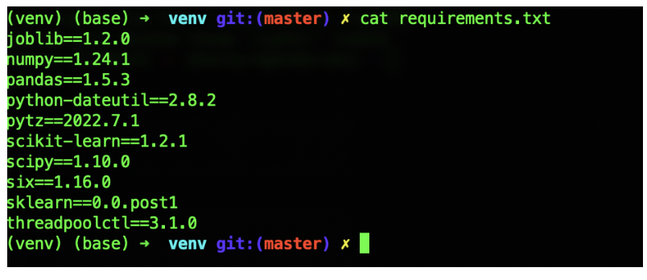
SYSTEM DETAILS - MACHINE LEARNING MODEL
Scripts to launch the model

Slide 14
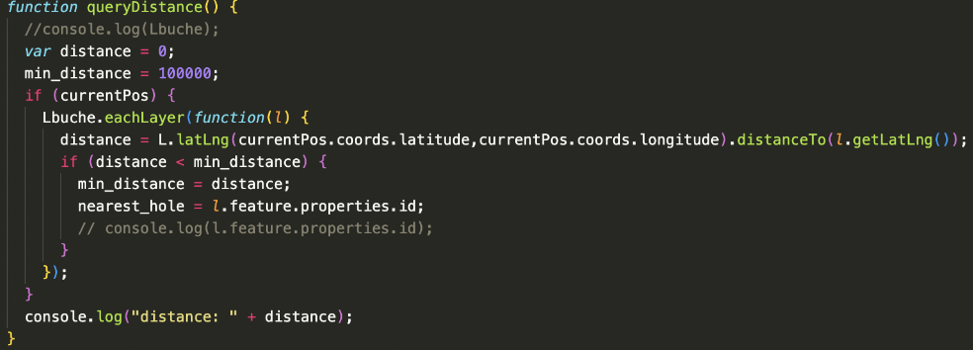
SYSTEM DETAILS - ALERT SYSTEM
Function to calculate distance between points

Slide 15
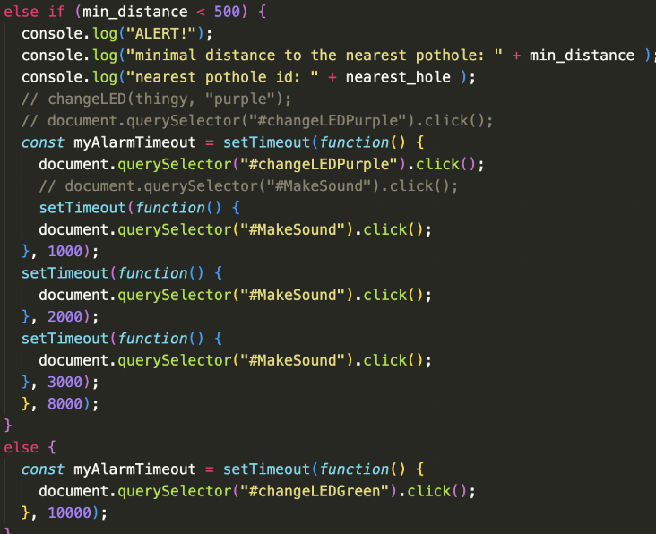
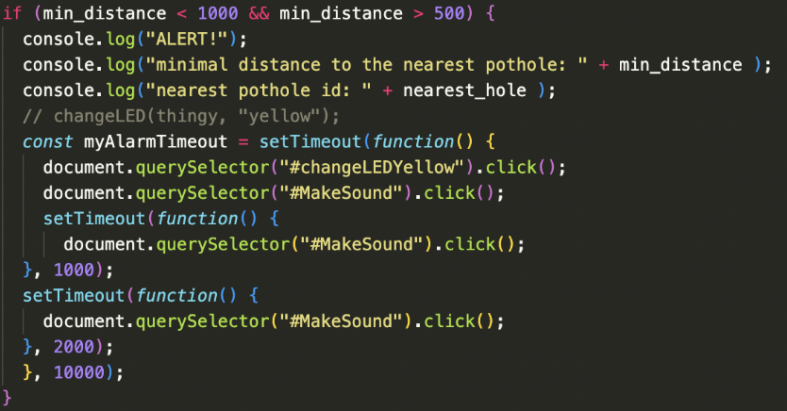
SYSTEM DETAILS - ALERT SYSTEM
If statements of the alert system

Slide 16
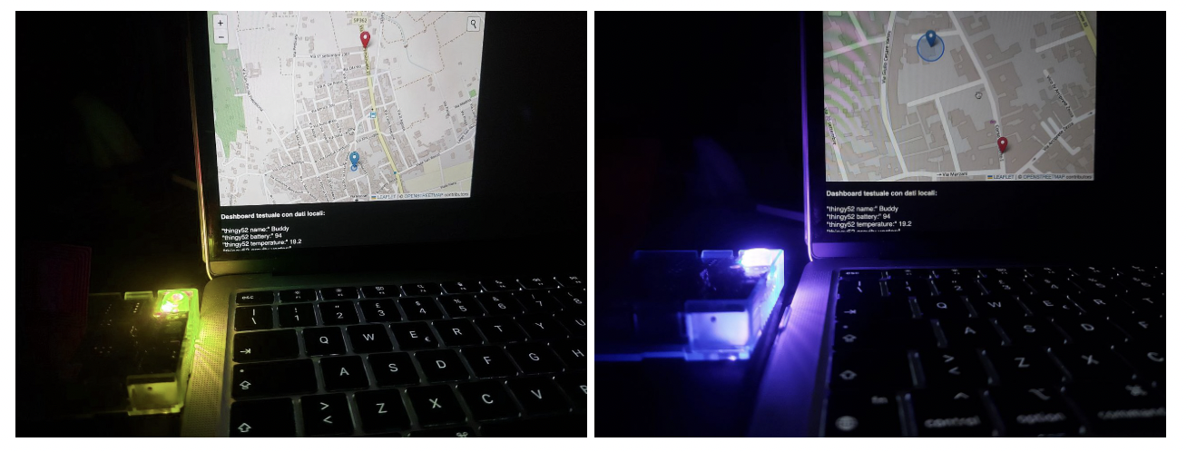
VALIDATION - TEST 1
Test on alert system

Slide 17
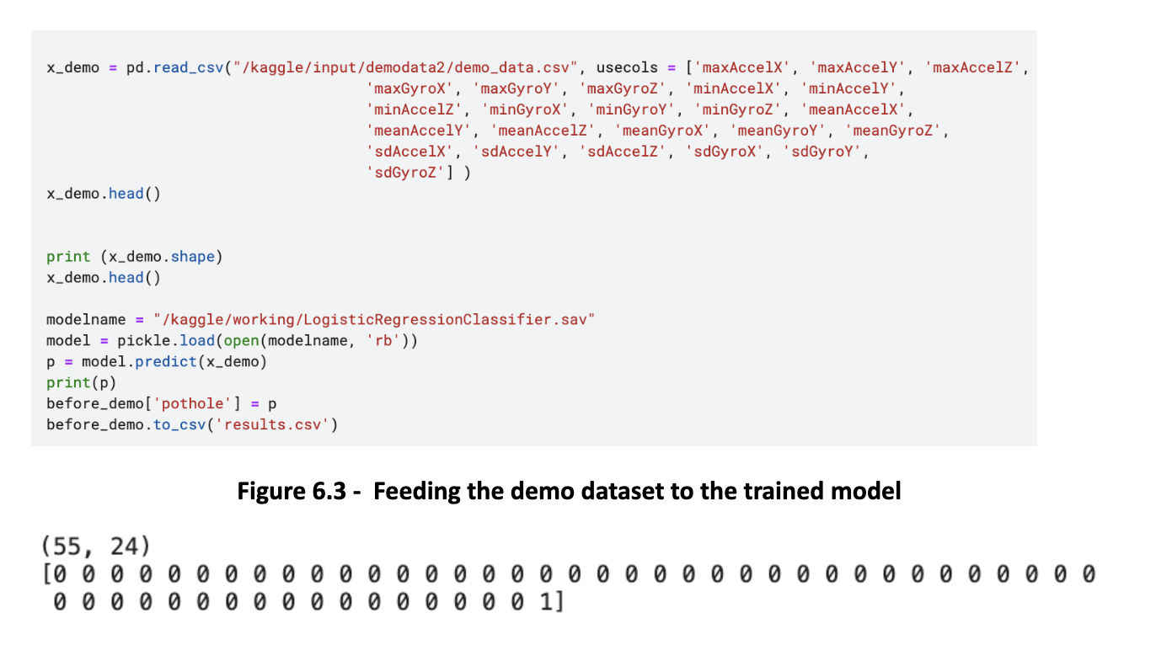
VALIDATION - TEST II
Test on the model’s accuracy

Slide 18
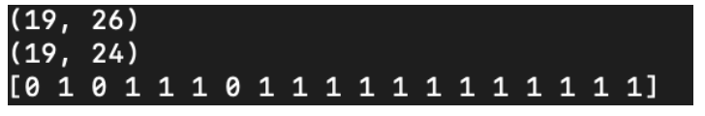
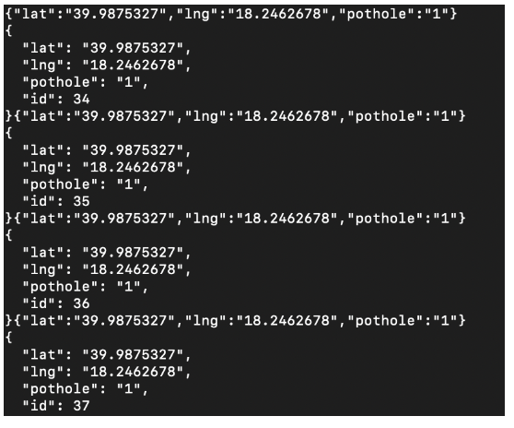
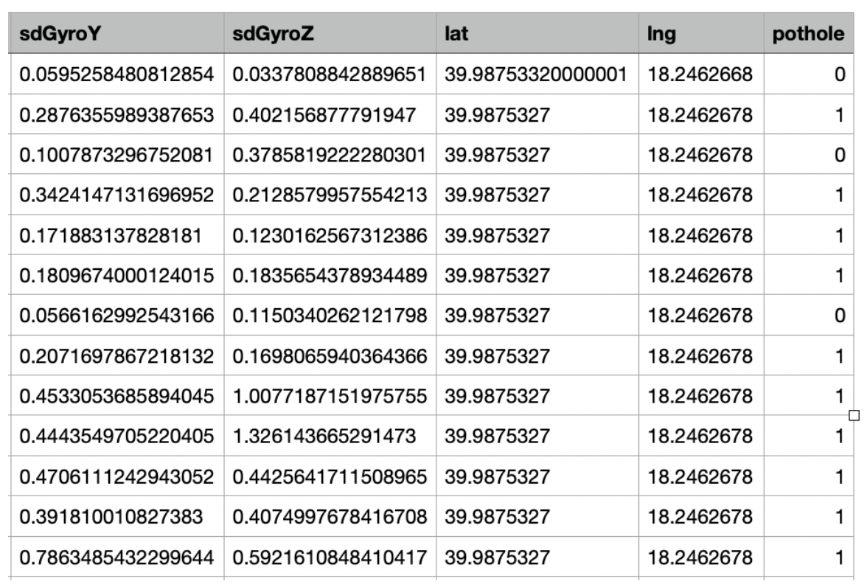
VALIDATION - TEST III
Test on data elaboration.

Slide 19
CONCLUSIONS AND FUTURE WORKS
Test while driving on both poor and good road conditions.
The project could be used in the future to create a road parameters dataset.
Differentiation between users accessing the app.
Practical use for environmental sensors like the CCS811 Digital Air Quality Sensor and BH1745 Digital Color Sensor.
Including a Raspberry Pi Zero board.

Slide 20
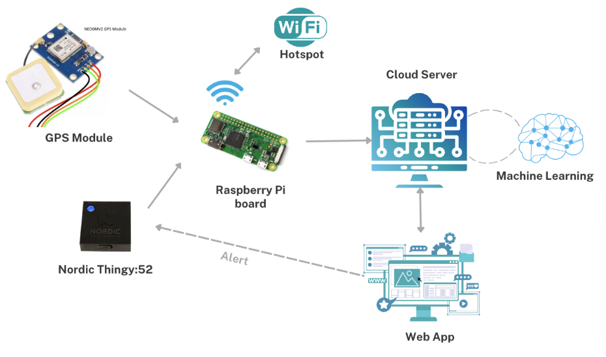
CONCLUSIONS AND FUTURE WORKS

